Slide 1
Chpt 2: Supply and Demand
Part 2

Slide 2
Microeconomics: Consumer and Firm Behavior
Most economic activity takes place in markets: trade money for a good or service
Model of supply and demand describes how markets work
What does it do?
S/D curve
Horizontal → quantity
Vertical → price

Slide 3
Demand
Buyers want to buy things
Example: demand for cabbages
Price | Quantity
0.50 | 15
1.00 | 7
2.00 | 5

Slide 4
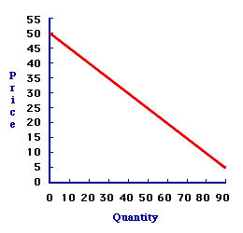
Demand curve
Inverse relationship → higher the price → less quantity people demand → always downward
Law of demand

Slide 5
Supply
Sellers want to sell things
Same example with cabbage
Price | Quantity
0.50 | 5
1.00 | 10
1.50 | 15

Slide 6
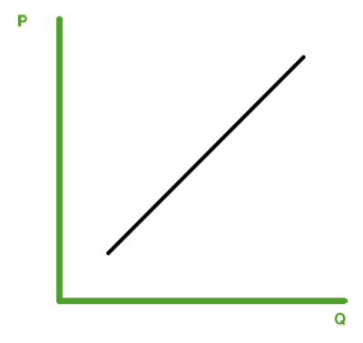
Supply curve
Direct relationship → More quantity produced → higher it costs to produce it → always upward
Law of supply

Slide 7
Market equilibrium

