Slide 1
Chapter 2: S/D
Part 4

Slide 2
Types of demand
Demand is the quantity of a good or service that consumers are willing and able to buy at a given price in a given time period.
Effective demand: Effective demand is when a desire to buy a product is backed up by an ability to pay for it
Latent demand: exists when there is willingness to buy among people for a good or service, but where consumers lack the purchasing power to be able to afford the product.
Derived demand – a demand for good/service that is a consequence for the demand for something else

Slide 3
Price control

Slide 4
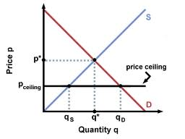
Price ceiling

Slide 5
Price flooring

