Slide 1
Chapter 2: S/D
Part 5

Slide 2
Demand and Supply Shifters

Slide 3
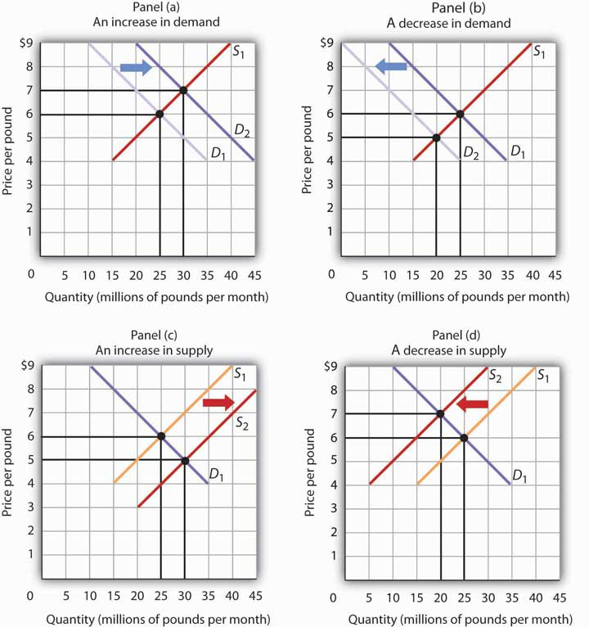
Demand Shifters
5 demand shifters (PRICE IS NOT A SHIFTER)

Slide 4
P2
P1
Q1
Q2

Slide 5
P1
P2
Q2
Q1

Slide 6
Supply Shifters
6 supply shifters (PRICE IS NOT A SHIFTER)

Slide 7
P1
P2
Q1
Q2

Slide 8
P2
P1
Q2
Q1

