Slide 1
Chapter 2: Supply and Demand
Part 6
You will need your calculator for this PP

Slide 2
Elasticity
If I lower or raise the price of my product, how much more or less will I sell?
Elasticity of demand
Price sensitivity
Elastic = a small change in price, will result in a big change in quantity demanded
Inelastic = a small change in price, will results in a small change in quantity demanded

Slide 3
Determining PE
1st = evaluating the type of product = availability of substitutes
More substitutes = elastic
Less substitutes = inelastic

Slide 4
Elastic Example
Coffee
$2.00 – 8 oz = 1 day
$2.50 – 8 oz = 1 week
$1.50 – 8 oz = 2 day

Slide 5
Inelastic example
Caffeine
$100 = 1 kg = 100 kg/week
$110 = 1 kg = 99 kg/week
$90 = 1 kg = 101 kg/week

Slide 6
Elasticity of Medical Services
Primary Care Physician vs. Sub-specialty (orthopedic surgeon)
Eye glasses versus a hearing aid
Psychologist vs. Psychiatrists

Slide 7
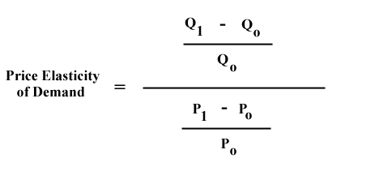
Determining PE
2nd way is through the elasticity formula

Slide 8
Determining PE
PE > 1 = elastic = sensitive to change
PE < 1 = inelastic = not sensitive to change

Slide 9
Calculate
P0 = $8
P1= $10
Q0 = 50
Q1 = 30

Slide 10
Calculate
P0 = $12
P1 = $6
Q0 = 40
Q1 = 50

Slide 11
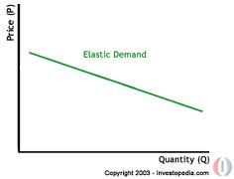
3rd way is looking at the graph

Slide 12
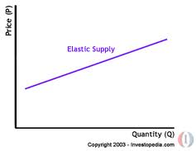

Slide 13
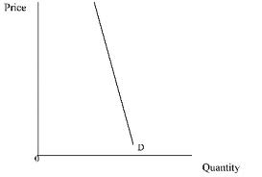

Slide 14
