Slide 1
Chapter 2: Supply and Demand
Part 7

Slide 2
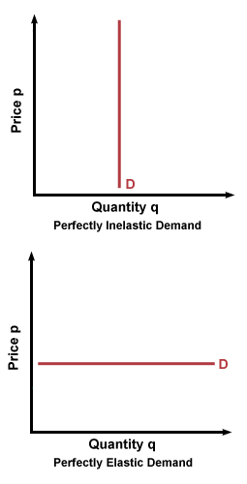
Perfectly Elastic Good/Service

Slide 3
Perfectly Inelastic Good/Service

Slide 4
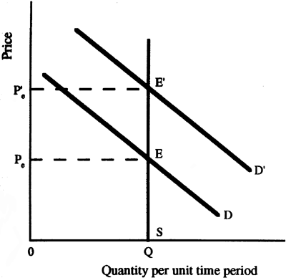
Fixed Supply

Slide 5
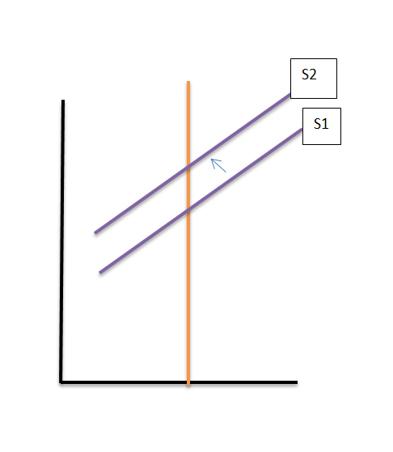
Fixed Demand

