Slide 1
Chapter 4
Part 2

Slide 2
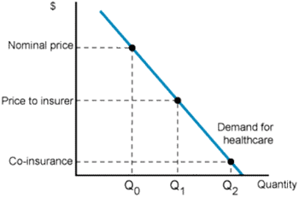
Moral Hazard

Slide 3
Amount of Moral Hazard depends on PED
P0
P1 (+I)
Q0
Q1
Q2

Slide 4
Effect of Increased Benefits Cost on Price (Wages) and Quantity of Labor***
Benefits
Wages
Quantity = Number of employees @ firm

