Slide 1
Module 5
HC Economics
Students

Slide 2
How does insurance work
Characteristics of insurance
Risk pooling
Payment only for random losses
Risk transfer
Indemnification

Slide 3
Key concepts
Why is insurance called third party payer
Risk aversion = extent to which an individual is willing to pay to reduce variation in losses or income due to random events

Slide 4
Issues with health insurance
Adverse selection = People who choose to purchase insurance are likely to be a group who needs the insurance
Moral hazard = Use of medical services because the service is covered by insurance
Problem is that it drives up cost

Slide 5
Types of insurance
Social insurance = form of insurance sponsored by the government to help those in need
Indemnity = pay for all (or a defined part) of the medical bills
Managed care = a system of health care in which patients agree to visit only certain doctors and hospitals, and in which the cost of treatment is monitored by a managing company.
Consumer-driven health plans = focus on consumer searching for hc with high quality and lower costs

Slide 6
Important concept = tax exempt status of HI

Slide 7
Who provides health insurance
2 groups
Public
Private
Small percentage also covers = charity care

Slide 8
Uninsured and underinsured
Uninsured = people who do not have health insurance
Underinsured = people who have health insurance but do not have enough coverage
Notes:
Total population = 324 million

Slide 9
Public insurance
Entitlement
Budget
Global budget
ESHI

Slide 10
Medicare
Federal government
Who is covered?
1965
M/M Johnson
A = Hospitals
B = Physicians
C = Additional services
D = Rx

Slide 11
Medicaid
Federal and state government
Who is covered?
Income assessment = Children, pregnant women, families, certain disabilities
Nursing home = highest payouts

Slide 12
Private insurance
ESHI
Most common way that people are insured
Major flaw of ESHI
Group
Individual

Slide 13
Key terms
Premiums= cost you pay for HI coverage
Monthly; annually
Cost-sharing
Deductible = amount that must be paid before insurance covers the costs
Co-pay = flat fee that a person pays for services
Co-insurance = your share of health services calculated as a percentage after
Gatekeeper = primary care provider that refers patients as needed

Slide 14
Reimbursement methods
Retrospective payment = Retrospective payment plans pay healthcare providers based on their actual charges
Prospective payment = Prospective payment plans work by assigning a fixed payment rate to specific treatments.
Capitation = based on a payment per person, rather than a payment per service provided.
Pay for performance = describes health-care payment systems that offer financial rewards to providers who achieve, improve, or exceed their performance on specified quality and cost measures, as well as other benchmarks

Slide 15
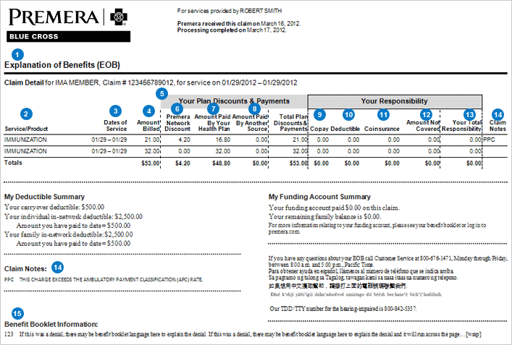
EOB

Slide 16
Other important information
Insurance is regulated at the state level
Insurance is typically required to access health care

