Slide 1
Health Reform
PPACA

Slide 2
BACKGROUND
PPACA = Patient Protection and Affordable Care Act
March 23, 2010
President Barack Obama
June 27, 2012
Ruled 5-4
Clarence Thomas
Antonin Scalia
Samuel Alito
Anthony Kennedy
Congress does not have authority under the Commerce Clause of the U.S. Constitution to require individuals to own a minimum level of insurance (penalty) but does have the authority to use its taxation authority to impose a coverage mandate
Goals: Aimed primarily at decreasing the number of uninsured Americans and reducing the overall cost of health care
http://www.healthcare.gov/

Slide 3
HEALTH INSURANCE MARKETPLACE
Oct 1 2013
Open enrollment in health insurance market begins
Must live in US
US citizen or national
Not incarcerated
Run at state level
- Run their own
- Partner with government

Slide 4
Jan 2014
Americans who earn less than 133% of the poverty level (approximately $14,000 for an individual and $29,000 for a family of four) will be eligible to enroll in Medicaid. States will receive 100% federal funding for the first three years to support this expanded coverage, phasing to 90% federal funding in subsequent years.

Slide 5
Jan 2014
Tax credits to help the middle class afford insurance will become available for those with income between 100% and 400% of the poverty line who are not eligible for other affordable coverage.
Single person = 14,000 – 43,320
Family (4) = 25,000 – 88,200

Slide 6
WHAT IS TO COME?
Jan 2014
Most individuals who can afford it will be required to obtain basic health insurance coverage or pay a fee to help offset the costs of caring for uninsured Americans. If affordable coverage is not available to an individual, he or she will be eligible for an exemption.

Slide 7
How do we pay for it? WHAT PROVISIONS AFFECT YOU?
Individual mandate = “shared responsibility payment”
Medicare surtax = only 200K (additional 0.9% on top of 1.45%)
Tax filers now may only deduct medical expenses that exceed 10% of their adjusted gross income. Previously, the threshold was 7.5% of AGI.
20,000 = 2000 (10%)
20,000 = 1500 (7.5%)
Higher penalty, on nonqualified HSA distribution
Previously 10% now 20%
Tanning tax = 10%
Lower limit on FSA
5000 (416) to 2500 (208)
20,000 – 416
20,000 – 208

Slide 8
Exempt from tax
You’re uninsured for less than 3 months of the year
People with religious objections
Part of a healthcare sharing ministry
Native Americans with coverage through IHS
Undocumented immigrants
Those in prison
Lowest-cost plan exceeds 8% of annual income
10K = 801/YEAR
Incomes below tax filing thresholds
9K singles
19K couples < 65

Slide 9
Exempt
Hardship
Homeless
Evicted/foreclosure
Shut-off from utility
Death of a close family member

Slide 10
How much will the tax be?
Higher of the 2
2014
$95/person (up to 3) or 1% of taxable income
Example
Family of 3 earning 35,000 taxable income
$285
$350
2015
$325/person (up to 3) or 2% of taxable income
2016
$695/person (up to 3) or 2.5% of taxable income

Slide 11
How tax credit will work
You’ll go to market and be able to use tax credit to help pay for premiums (vs. credit at time of taxes)
You’ll get a statement
Tax credit = sliding scale
Avg = 5K/year
No premiums = $416 month

Slide 12
Will I get a tax credit (subsidy)
http://kff.org/interactive/subsidy-calculator/

Slide 13
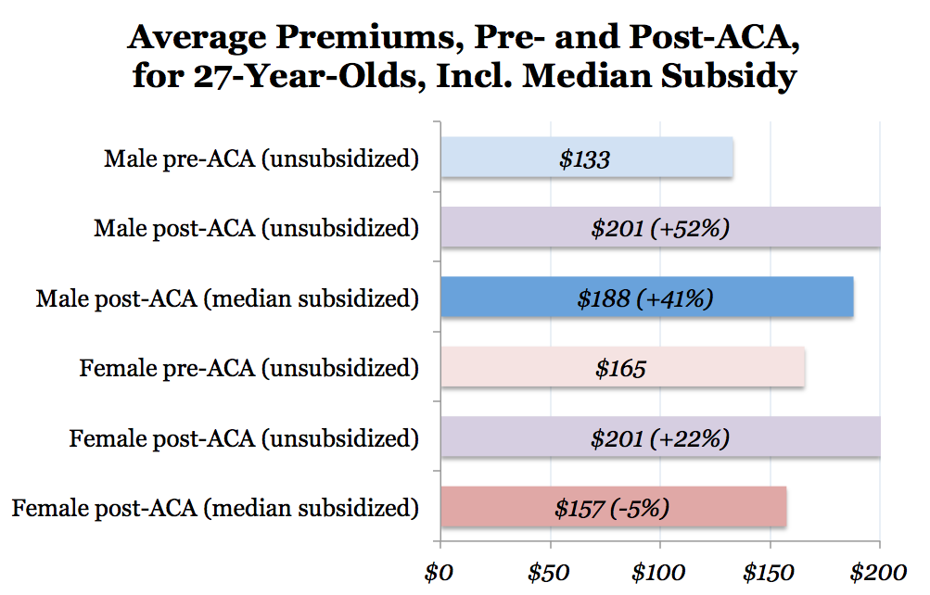
Notes:
What seems to be the problem?
-

Slide 14
http://www.forbes.com/special-report/2013/what-will-obamacare-cost-you-map.html

Slide 15
Those that are losing coverage
Ambulatory care
Hospitalization
Mental health and substance abuse treatment
Rehabilitative and Habilitative Services
Preventative and chronic disease management
Emergency Care
Maternity Care
Prescription drugs
Laboratory services
Children’s dental and vision care

Slide 16
Employer mandate delay
Under the requirement, employers with at least 50 full-time workers must provide affordable health coverage or face a $2,000 fine per worker after the first 30 employees. In separate announcements posted July 2 on the White House blog and Treasury Department's blog, officials said the employer coverage mandate will be delayed until 2015 to provide businesses with more time to comply with its reporting requirements (California Healthline, 7/3).

Slide 17
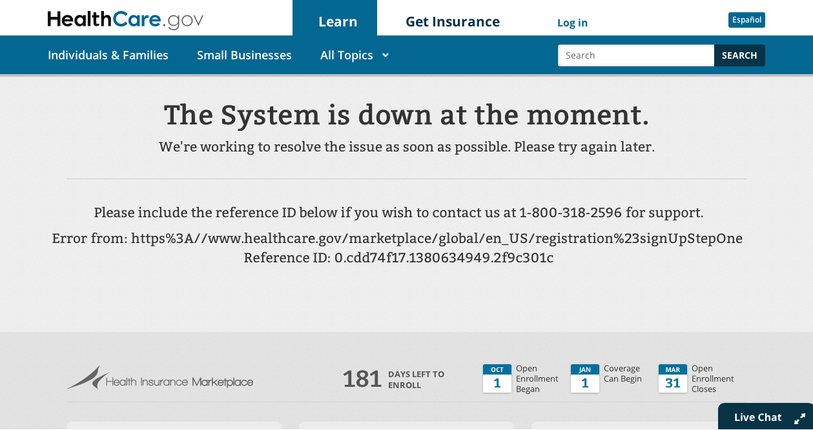
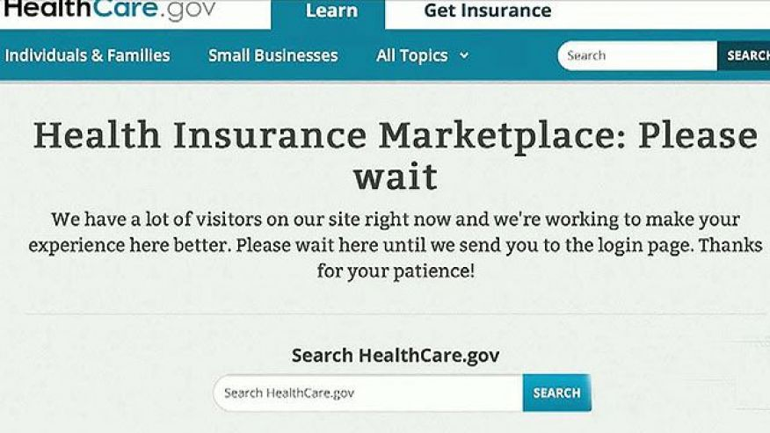
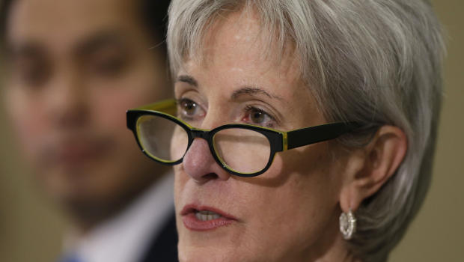
In the news

Slide 18
MARCH 31, 2014
OPEN ENROLLMENT CLOSES

