Slide 1
Chapter 7
Part 3

Slide 2
Cost allocation
A pricing process with the organization whereby managers allocate the costs of one department to another department.

Slide 3
Responsibility centers
An organizational unit for which a manager is made responsible
An organizational unit for which a manager is made responsible

Slide 4
Types of responsibility centers
Revenue centers – manager is responsible for generating revenue
Cost centers – manager responsible for costs only. Has no control over sales or generates revenue. Performing measured by comparing actual and budget costs
Profit centers – manager responsible for revenue and costs, generating profit
Investment centers – manager is responsible for revenue, costs, and investments

Slide 5
Cost allocation continued
START WITH A SIMPLIFIED VERSION = YOU AND YOUR FRIEND ARE ROOMATES.
What are the costs that have to be shared between you are your roommate?
Now how do you divide up the cost?

Slide 6
Cost allocation cont.
Now, here comes the problem
Rent – your roommate has the bigger bedroom
Power – Your roommate needs it to be cold all the time – power bill goes up and she goes to class on-line and spends all day at home
Food – She has to have organic food and only name brand items

Slide 7
Cool Pool and Drivers
Cost pool = all of the entities that have to have cost allocated towards them – but don’t earn money
Environmental services
Maintenance
Accounting
Human resources
Information systems
Cost drivers = how do they drive up cost (measure the cost)
Environmental services – square foot
Maintenance – number of equipment
Accounting – volume of services
Human resources – number of personal in the department
Information systems – number of equipment that is maintained

Slide 8
HOW TO ALLOCATE

Slide 9
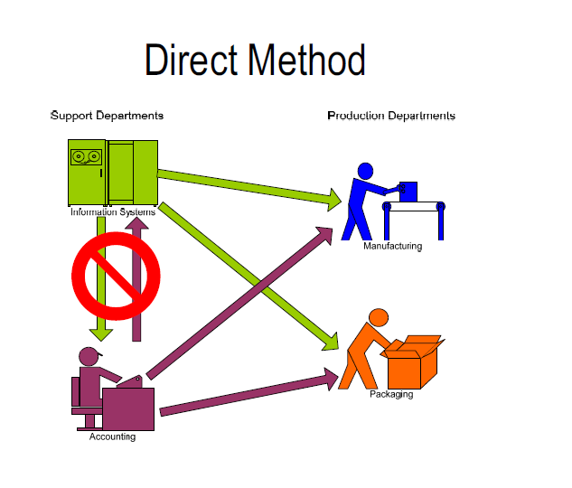
Direct allocation method
Allocates support costs only to operating department

Slide 10
DEPARTMENT | COST OF RUNNING DEPARTMENT | $ OWED BY DEPT – 4 ACCOUNTING | $ OWED BY DEPT – 4 INFORMATION SYSTEMS | TOTAL MONEY OWED
ACCOUNTING | 5,000 | 0 | 0 | 0
INFORMATION SYSTEMS | 8,000 | 0 | 0 | 0
EMERGENCY DEPARTMENT | 15,000 | 2,500 | 4,000 | 15K +2.5k + 4k
PHYSICAL THERAPY | 9,000 | 2,500 | 4,000 | 9K +2.5k +4K

Slide 11
2nd way is step-down
Start by arranging things as a hierarchy – where the entity that provides services to the most gets put on top and then once it is allocated the entity is closed
Bill that everyone needs to pay into
RENT AND UTILITIES
Department that provides support to everyone
EXECUTIVE OFFICE
FINANCIAL AFFAIRS
Department that clinics uses that multiple entity will use
IMAGING
NURSING
LABORATORY
Clinics that receive most $$
PEDIATRICS
ADULT MEDICINE

Slide 12
 | DIRECT COST | EXE | FA | IM | NUR | LAB | PED | AM | TOT
R/U | 15,000 | X | X | X | X | X | X | X | 15k
EXE | 12,000 | -- | X | X | X | X | X | X | 12k
FA | 4,500 | -- | -- | x | x | x | X | x | 4.5k
IM | 12,500 | -- | -- | -- | -- | -- | X | X | 12.5k
NU | 16,000 | -- | -- | -- | -- | -- | X | X | 16k
LAB | 22,000 | -- | -- | -- | -- | -- | X | X | 22k
PED | 45,000 | -- | -- | -- | -- | -- | -- | -- | ?
AM | 52,000 | -- | -- | -- | -- | -- | -- | -- | ?
TOTAL | 179,000 |  |  |  |  |  |  |  | 179K

Slide 13
ABC
Activity-based costing (ABC) : Assigns cost by looking at how much of the resources are used and assigns cost
Environmental services – square foot
Maintenance – number of equipment
Accounting – volume of services
Human resources – number of personal in the department
Information systems – number of equipment that is maintained

Slide 14
COST POOL | COST DRIVERS | RATE | TOTAL ACROSS ORGANIZATION | COST TO RUN DEPARTMENT
ES | SQ FOOTAGE | $6.00 | 5000 | $30,000
MAIN | NUMBER OF EQUIPMENT | $12.00 | 100 | $12,000
ACCT | VOLUME OF SERVICES | $10.00 | 10,000 | $100,000
HR | NUMBER OF EMPLOYEES | $20 | 500 | $10,000
IS | NUMBER OF EQUIPEMNT | $30 | 100 | $3,000

Slide 15
DEPARTMENT | ES 5000 $6.00 | MAIN 100 $12.00 | ACCT 10,000 $10.00 | HR 500 $20 | IS 100 $30
EMERGENCY DEPT | 2500 | 40 | 5000 | 300 | 50
GIFT SHOP | 500 | 20 | 0 | 10 | 2
PHYSICAL THERAPY | 1000 | 20 | 2000 | 90 | 8
PC - CLINIC | 1000 | 20 | 3000 | 100 | 40
TOTAL | $30,000 | $12,000 | $100,000 | $10,000 | $30,000

