Slide 1
Chapter 6: Physicians
Health Economics

Slide 2
PROVIDER – PHYSICIAN - DOCTOR

Slide 3
6.1 financing physicians services revenue

Slide 4
Does payment type affect your ability to get seen?
Medicaid
BC/BS
Medicare

Slide 5
rbrvs
Higher number = More work/effort = More money
CF = conversion factor
GPCI = Graphic practice cost index
PW = physician work
PE = Practice Expense
Facility = Hospital
Non-facility = Physician office
MI = Malpractice insurance

Slide 6
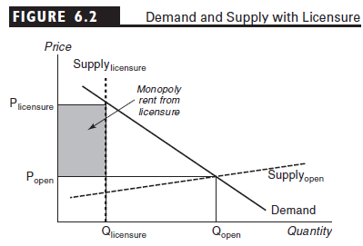
How does licensure increase physician profits

Slide 7
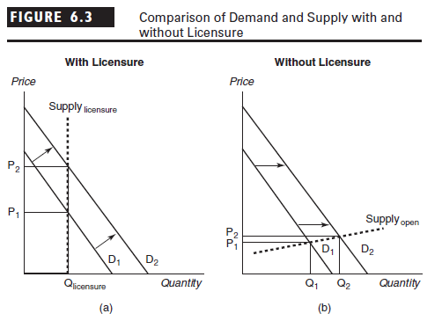
Supply and demand response to licensed versus unlicensed professions***

