Slide 1
Chapter 11: Pharmaceuticals
Continued

Slide 2
Pharmaceutical Discoveries and Problems

Slide 3
1922
Insulin Discovered
Diabetes mellitus (sweetened with honey)
Medical researcher Frederick Banting and research assistant Charles Best
Isolated insulin and successfully tested it on diabetic dogs, lowering the dogs' blood sugar level.
On January 11, 1922, Leonard Thompson, a 14-year-old boy who was dying of diabetes, was given the first human experimental dose of insulin.
The insulin saved his life.
In 1923, Banting and Macleod were awarded the Nobel Prize for their work on discovering insulin.
What was once a death sentence, people now diagnosed with diabetes can live long lives thanks to the work of these men.

Slide 4
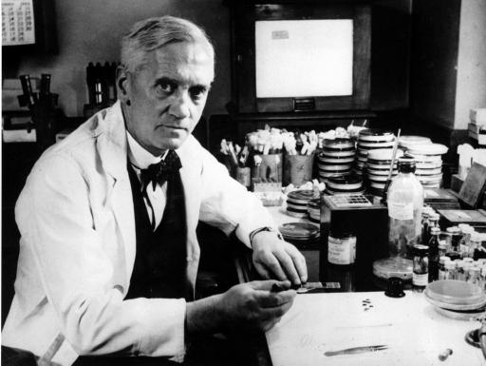
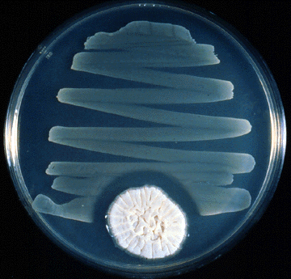
1928
Beginning of antibiotic discovery
Nobel laureate Sir Alexander Fleming
Penicillium = fungi had antibiotic properties – Penicillin
Accident

Slide 5
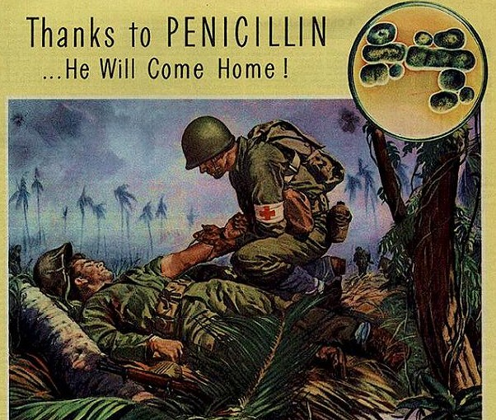
1928 continued
World War II
Number of deaths and amputations caused by infected wounds
Issues
Difficult to manufacture in large quantities
Rapid renal clearance – frequent dosing
80% cleared within 3-4 hours
Collect urine from patients to be reused
Cures
pneumonia, meningitis, scarlet fever, diphtheria, blood poisoning, syphilis, gangrene, strep throat and gonorrhea

Slide 6
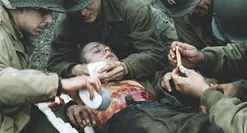
1937
Sulfa drug
Antibacterial
Yellow powder – Saving Private Ryan
Awkward to injest → Goody Powder
Didn’t dissolve in water or alcohol
ethylene glycol → antifreeze → taste great → kill you
Didn’t break any laws
Mislabeling = elixir
Fined $26,100
$419,425.19
Killed more than 100 people

Slide 7
1938: Food, Drug and Cosmetic Act
Development of FDA (Food and Drug Administration)
Set of laws passed by Congress
Pre-registration of all new drugs with the FDA → test drugs
Prevent unsafe drugs from entering market (exclude drugs by trained professionals for testing clinical trials)
Increase amount of information on labels without a Rx
Separated OTC & Rx drugs
All new drugs were then Rx
Unintended consequence – restrict ability to self-medicate
Originally intended to place more dangerous under medical supervision

Slide 8
Economic effect of the FDA
Limit sales to Rx only – more inelastic – charge price that wouldn’t effect quantity
Why inelastic
No substitutes
Rx appeared more effective
Medical science supported restrictions

Slide 9
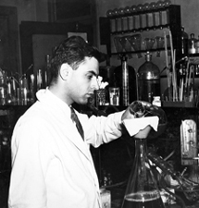
1943
Streptomycin
Antibiotic drug
Tuberculosis, Endocarditis, The Plague
Albert Schatz – graduate student at Rutgers University

Slide 10
1940 key changes
Discovery of streptomycin
US patent office said that chemical modifications made to streptomycin created a new product
Process is patented
Instead of licensing patents to competitors, pharmaceutical firms began to exercise patent rights to control production, distribution, and price
Result:
Modern style of R&D
Use of patents to maintain price

Slide 11
1957
Thalidomide was developed by German pharmaceutical company by Heinrich Mückter, a former Nazi Party member
Thalidomide
Tranquilizer and painkiller
Insomnia, coughs, colds, and headaches
Morning sickness
Drug wouldn’t pass through placental barrier
In the late 1950s and early 1960s, more than 10,000 children in 46 countries were born with deformities due to thalidomide use.
The FDA never licensed thalidomide for general use; some of the birth defects caused by thalidomide in the United States were results of the drug being obtained from other countries.
However, samples had been distributed to a number of physicians as part of a clinical trial, in which 20,000 patients in the United States received thalidomide.

Slide 12
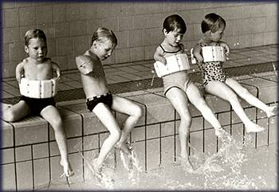
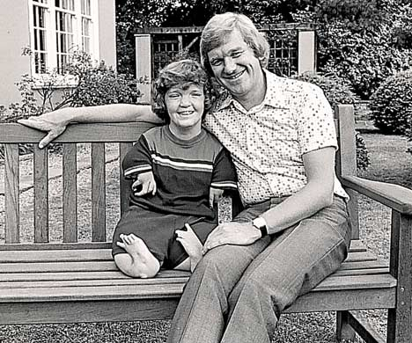
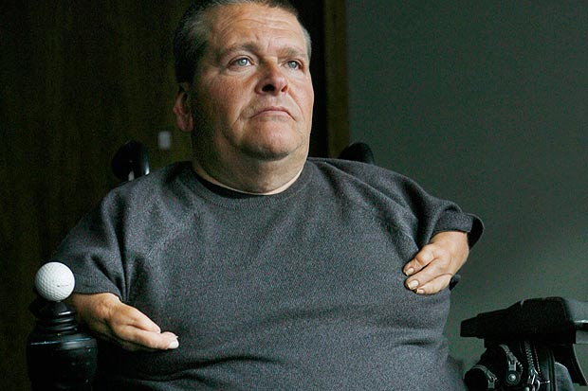
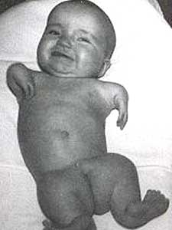

Slide 13
1984
Drug Price Competition and Patent Term Restoration Act AKA “Hatch-Waxman Act" established the modern system of generic drugs
When a pharmaceutical company first markets a drug, it is usually under patent that, until it expires, allows only the pharmaceutical company that developed the drug (or its licensees) to sell it.
Generic drugs can be produced without patent infringement for drugs where:
the patent has expired
the generic company certifies the brand company's patents are either invalid, unenforceable or will not be infringed,
for drugs which have never held patents, or
in countries where the drug does not have current patent protection.
Patent lifetime differs from country to country; typically an expired patent cannot be renewed.
In the U.S., patent extensions may be granted if changes are made;
Change to shape and color
A new version of the drug with significant changes to the compound could be patented, but this requires new clinical trials.
In addition, a patent on a changed compound does not prevent sales of the generic versions of the original drug unless regulators take the original drug off the market
This allows the company to recoup the cost of developing that particular drug.

Slide 14
Result of the Act
The primary being the robust generic drug industry that only began to flourish

Slide 15
Are generics equivalent
A major assumption within the Hatch-Waxman Act concerns the sameness of a generic drug to the pioneer.
Currently the FDA’s method of determining similarity between drugs is through a comparison of the bioavailability, the amount of active ingredient in the blood over a period of time.
The FDA holds that if the proposed generic comes within plus-or-minus twenty percent of the bioavailability of the pioneer drug, then the drugs are sufficiently similar.

Slide 16
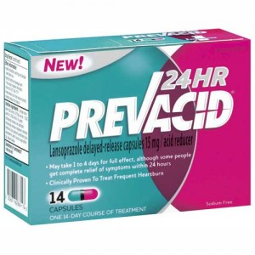
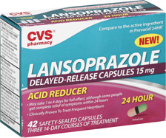
Generics and Patents
A generic drug is a drug product that is comparable to brand/reference listed drug product in dosage form, strength, route of administration, quality and performance characteristics, and intended use.
Available once patent expires (20 years)
7-12 years
Subject to same regulations
Market competition – lowers prices
Generic drugs are labeled with the name of the manufacturer and the adopted named (nonproprietary name) of the drug.
Example: Lansoprazole
Generic: Lansoprazole
Brand: Prevacid

Slide 17
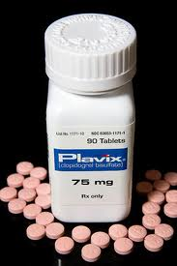
Economics of generics
How do generics lower cost?
Competition
Loss of monopoly
Fewer cost
Previous marketing efforts & brand loyalty
Manufacture vs. R&D
For example, Thailand has imported millions of doses of a generic version of the blood-thinning drug Plavix (prevents heart attack) at a cost of 3 US cents per dose, from India, the leading manufacturer of generic drug
Clopidogrel
Generic
30-day supply = $0.53
Brand-name Plavix
30 day supply = 6.58
Thailand
30 day supply = $0.90
What do brand-name companies due to off-set this loss?
Set a price which maximized profitability
Profit often greatly exceeds the development of the drug

Slide 18
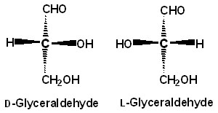
Challenging patents
Brand-name drug companies have used a number of strategies to extend the period of market exclusivity on their drugs, and prevent generic competition.
This may involve aggressive litigation to preserve or extend patent protection on their medicines.
Timing
Patents are typically issued on novel pharmacological compounds quite early in the drug development process, at which time the ‘clock’ to patent expiration begins ticking.
Later in the process, drug companies may seek new patents on the production of specific forms of these compounds, such as single enantiomers of drugs which can exist in both “left-handed” and “right-handed” forms
If granted, these patents ‘reset the clock’ on patent expiration.
These sorts of patents may later be targeted for invalidation by generic drug manufacturers.
Relevant examples
Glyceraldehyde, Dihydroxyacetone
Erythrose
Ribose, Ribulose, Xylulose
Glucose, Galactose, Mannose, Fructose

Slide 19
Lipitor
Pfizer
American
Cholesterol-lowering drug
Best selling drug in pharmaceutical history
$125B
25% of all sales
Lost its patent this year (2012)
How much did it cost?
W/PATENT = 90-day supply = $225
W/O PATENT = 90-day supply = $158.98
Generic = 90-day supply = $134.67
What was their loss in overall profits? 19%

Slide 20
Research and Development
Most of the pharmaceutical
Many small companies
Produce 1-2 products
25 large that produce a lot
1-2 money maker
Cost of developed = $150M – 1.5B
Can take up to 10 years

Slide 21
Research and Development
Discovery stage
Patented
Lab tested
IND
Clinical trials
Synthesis stage
Tissue
Animals

Slide 22
Clinical trials
Phase I
Phase II
Phase III
NDA
FDA Approval

Slide 23
Pharmacoeconomics
Consumer & Pharmaceuticals: Are new drugs worth the price charged?
How much of a gain will this drug provide
How much will people value
Do other drugs provide similar effectiveness
How many people will benefit
Will some people benefit more than others
Will some people value the drug more than others

Slide 24
How can I participate in research?
http://www.clinicaltrials.gov/
https://www.researchmatch.org/
Go directly to institutions
http://www.uab.edu/news/reporter/clinical-trials

