Slide 1
FINANCE
BUDGETING

Slide 2
Budgeting
Budgeting in many thoughts, is the essence of financial management
A budget turn an operating plan into a program for the expenditures of funds
Also can be used as a tool for evaluation

Slide 3
Some budget fables

Slide 4
But we have a budget
Looking at a budget is a whole and not as parts
Problem: Can’t see where changes need to be made
Example 15,000 month or
5,000 salary
100 electricity
600 rent
Etc.
Patient accounts receivable
Total = 5,000
Versus = BC/BS; Medicare; Medicaid

Slide 5
Take it from the telephone budget
Budget should be stuck to and not borrowed/used from another budget
Problem: Inconsistent information
Telephone budget = $500
Take $400 = cut down your telephone to $100, now you don’t have the money

Slide 6
Sit down and copy numbers from last years budget
Needs may change
Spend same amount on supplies, but don’t need it, but now stuck with inventory and not enough $$ to do everything (shortage/surplus)

Slide 7
Components of the budget
Figure 8-1 page 151
Statistics B
Forecast utilization by service type
Revenue B
Prediction for how much revenue anticipated operations will generate
Expense B
Prediction of the total expense that the organization will generate
Capital B
Plan for acquisition new long-lived assets
Cash B
Anticipated cash in and out of the organization

Slide 8
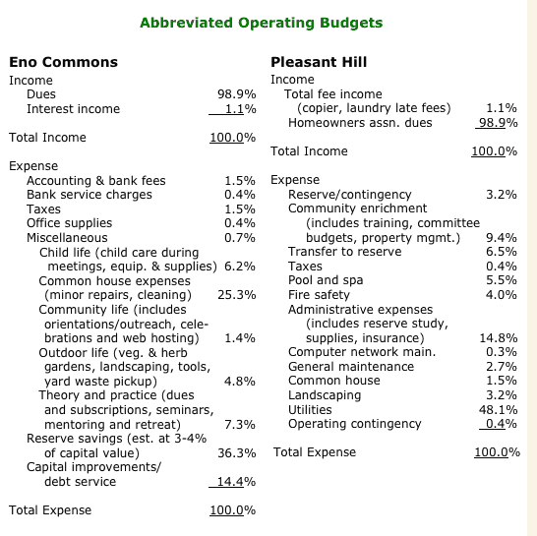
Operating/Statistics Budget

Slide 9
Revenue Budget

Slide 10
Expense Budget

Slide 11
Capital Budget

Slide 12
Cash Budget

Slide 13
Budget choices
Fixed or flexible
Fixed B
One that is specified in advanced
Flexible B
Budget that will change dependent on volume
Which do you choose?
Depends on the type of service
Food service, ED, Pediatric, Gift shop

Slide 14
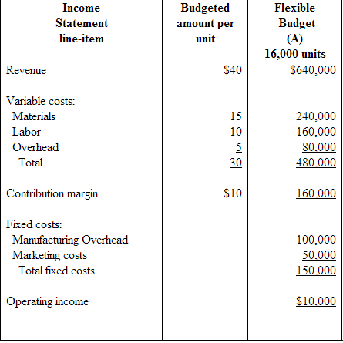
F v F

Slide 15
Zero-based B
Each proposed item in the expense budget must be justified and final budget should equal 0
Incremental budget
The next period’s budget is justified by the previous years (time period’s) budget
Which do you choose?
Depends on organization
Zero-based is most time consuming
Incremental (spend all)

Slide 16
Zero-based budget

Slide 17
Incremental budget

Slide 18
Top down = budget flows from the senior manager to operating personnel
Bottom-up = flows from operating personnel to senior management
Which do you choose?
Some feedback from operating personnel with final approval by senior management

