Slide 1
Module 8
Inventory Management
Chapter 18

Slide 2
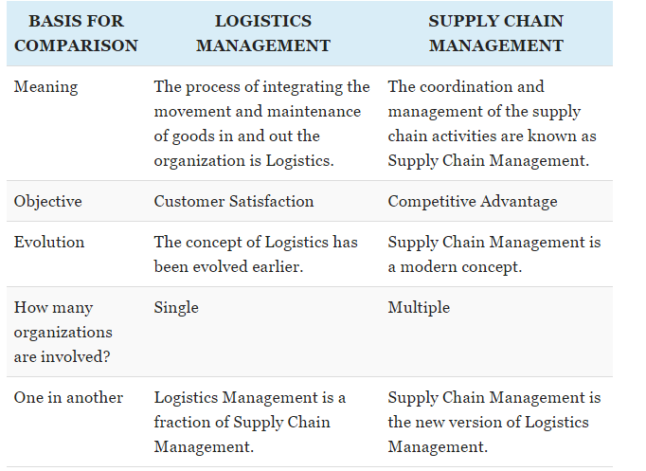
Supply chain vs. Logistics

Slide 3
Supply chain management
Supply chain management, then, is the active management of supply chain activities to maximize customer value and achieve a sustainable competitive advantage.
It represents a conscious effort by the supply chain firms to develop and run supply chains in the most effective & efficient ways possible.
Supply chain activities cover everything from product development, sourcing, production, and logistics, as well as the information systems needed to coordinate these activities.
Focused on supply and inventory

Slide 4
Top 10 healthcare supply chain companies
Mayo Clinic
Cardinal Health
Intermountain health care
Owens & Manor
Mercy
CVS Health
McKesson
AmerisourceBergen
Johnson & Johnson
Walgreens Boots Alliance

Slide 5
Top 10 logistics companies
UPS
XPO Logistics Inc.
J.B. Hunt Transport Services
C.H. Robinson Worldwide
Expeditors International of Washington
Ryder Supply Chain Solutions
DHL Supply Chain
FedEx Corp
Ceva Logistics
Americold Logistics

Slide 6
Terminology
Holding cost = Inventory and supplies impose holding costs such as temperature control, space, needing to be cleaned
Stock-outs = Occur when an organization’s inventory of some item falls to zero
Losses due to expiration, contamination, sales, and in-house usage
HCO = unacceptable and can result in unnecessary death and possible legal consequences
Balancing-how much
Safety stock level = Minimum amount of items that must be kept on-hand
Avoid stock-outs
Economic order quantity (EOQ) = Optimal amount of an itme
Eliminate loss of opportunity cost

Slide 7
Terminology
ABC inventory system = Each inventory or supply is categories as belonging to one of three categories
A = Expensive (Expensive pharmaceuticals)
B = All other items (Printer ink)
C = Inexpensive (Nonprescription pain relievers, bandages)
Just-in-time inventory management = supplies are delivered just as they are needed rather than in advance.
Requires a solid working relationship with suppliers and precise calculation of needed supplies
In HC = should be used for A items from ABC inventory system

Slide 8
Be on the lookout for..
Amazon
https://logistics.amazon.com/
Cheap → Convenient
Automation (Robots)

