Slide 1
Health Economics
Background – Part 2

Slide 2
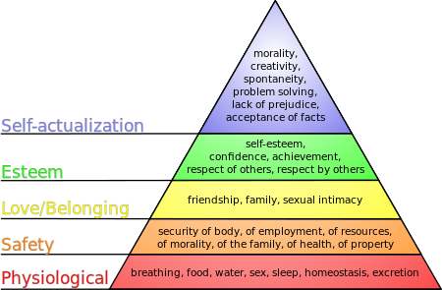
Satisfaction
Maslow’s hierarchy of Needs

Slide 3
Limitations
Physical limitations of nature (oil, water, food)
Allocation = laws; prices
Who gets what
Technology
Time

Slide 4
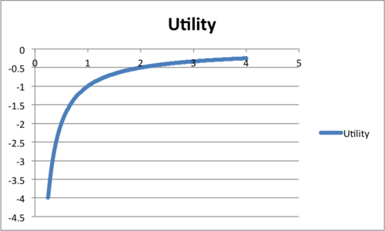
UTILITY
Economics suppose that you can compare all possible things that you may experience with common measure of happiness or satisfaction called utility
Marginal utility = is defined as that extra utility achieved by consuming on one more unit of a good.

Slide 5
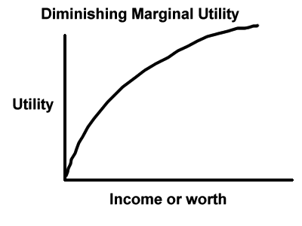
DMU
Diminishing marginal utility = each additional (marginal) unit that is consumed brings less utility than the previous unit so that the extra utility (marginal utility) brought by each successive unit diminishes as you consume more and more units.

Slide 6
MUTUAL BENEFIT
Has to be mutual benefits = both buyer and seller must benefit from transaction
Part of the fundamental theorem of exchange = both parties have to be better off, but does not take advantage of people so that one party is better off at the expense of the other

Slide 7
INVESTMENT
We put something of value into something for the future and also by switching some behavior we do it to get improvement

Slide 8
OPPORTUNITY COST
A core function of economics is the concept of opportunity cost – if I choose A, what will I not get by choosing B.
What I lose by not choosing B is the opportunity cost.
You choose what you want to do because it made you the happiest or gave you a good return
From the perspective of the person
Is the value of the best alternative thing you could’ve done instead

Slide 9
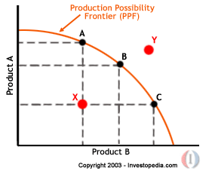
PRODUCTION POSSIBILITIES FRONTIER
Production possibilities frontier = shows how limited resources limit your ability to produce a product
Fundamental idea in economics is that there is no free lunch.

