Slide 1
Module 10. Cash management, Revenue cycle management
Chapter 17

Slide 2
Cash management
In order to minimize costs and plan ahead to finance deficits and invest excess cash, a HCO needs to identify the timing of its cash inflows/outflows
Inflows = patient revenues and other operating revenues, proceeds from investment, non-operating contributions
Outflow = what money is going out
Take inflow – outflow = ending cash balance
Many HCO require required cash balance (minimum balance)
Below = borrow
Above = invest

Slide 3
Accounts receivable management
AR, mostly through TP, constitute 75% of HCO current assets
Too high = lost returns in other investment opportunities

Slide 4
Accounts receivable management
75% of current assets
Most common from 3rd party payers
Medicaid = 45 days
Medicare = 15 days
MCO = 30 days

Slide 5
Methods to monitor
Track accounts and get your $$
Factoring
Selling off AR → bank/org → discount
Why? Need cash & can’t wait
Think selling would outweigh what you might get
Medicaid accts can’t be factor
Pledge AR as collateral
Give us $$ → if you don’t give it, have the AR

Slide 6
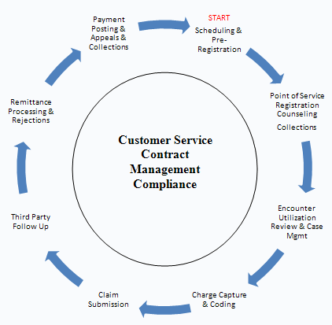
What can HCO do to get their $$
Notes:
Have sound revenue cycle management = All administrative and clinical functions that contribute to the capture, management, and collection of patient service revenue.
Scheduling & Pre-registration: Collection of all registration information, including eligibility, benefits and authorizations, prior to the patient's arrival for inpatient or outpatient procedures.
Point of service registration and collection = Collection of a comprehensive set of data elements required in establishing a Medical Record Number and satisfying regulatory, financial and clinical requirements.
Encounter utilization review & case management: Evaluation of the necessity, appropriateness, and efficiency of the use of medical services and facilities, which includes regular reviews of admissions, length of stay, services performed, and referrals.
Charge capture: Documented services are manually or electronically translated into billable fees. Coding: The process of transforming descriptions of medical diagnoses and procedures into universal medical code numbers.
- If it’s not documented it didn’t happen. If it’s not coded, you won’t get paid
Claim Submission: Billable fees are submitted to the insurance company via a universal claim form for payment.
Third Party Follow-up: Pursue collections from insurers after the initial claim has been filed.
Remittance Processing and Rejections: Posting or applying payments/adjustments to the appropriate accounts, including rejects.
Patient Collections: Collecting patient balances, making payment arrangements.

Slide 7
Other things
Watch and avoid fraud and abuse
Good system to deal with patients
Avoid denials

Slide 8
Fraud and abuse
Annual cost of HC – fraud = $75 – 250 Billion
M/M – improper payment of $65 Billion (fraud and error)
Good RCM also involves reviewing claims to catch fraud and abuse
Notes:
Fraud = deliberate
Error = non-deliberate
Variance analysis is what catches people

Slide 9
Common fraud/abuse/error
Billing for services not rendered
Billing for non-covered services as a covered service
Mispresenting
Upcoding of patient bills
DRG 89 – pneumonia with complications = $4,462
DRG 90 – pneumonia w/o complications = $2,791
Notes:
Check your bill
Misrepresentation
Dates of service= When insurance is covered
Location of service = Hospital v. physicians office v. home
Provider of service = 1 physician = 3 Nurse practitioners

Slide 10
Largest Medicare Fraud
Jacques Roy, M.D., 54, of Rockwall, Texas;
Cynthia Stiger, 49, of Dallas;
Wilbert James Veasey Jr., 60, of Dallas;
Cyprian Akamnonu, 63, of Cedar Hill, Texas;
Patricia Akamnonu, RN, 48, of Cedar Hill;
Teri Sivils, 44, of Midlothian, Texas;
Charity Eleda, RN, 51, of Rowlett, Texas,
Each with one count of conspiracy to commit health care fraud.
Notes:
$375 million
More than 500 Dallas-area home health care agencies have been accused of sending 11,000 people, some of them homeless, to Jacques Roy for fraudulent treatments.
Between 2006 and 2011, according to the 13-count indictment unsealed today, Dr. Roy certified more Medicare beneficiaries for home health services and had more patients, than any other medical practice in the United States. He allegedly even had a "boiler room" where employees worked all day signing his name on Medicare claims. Roy's company, Medistat Group and Associates, received hundreds of claims per day, and Dr. Roy allegedly instructed employees in the company's "485 Department," named for the "Plan of Care" form, to sign his name by hand or affix his electronic signature. Since 2006, according to prosecutors, Medistat Group and Associates has "certified more than 11,000 unique patients from over 500 home healthcare agencies in the Dallas-Fort Worth area." Medistat and the home health care agencies billed Medicare for more than $350 million and Medicaid for more than $24 million for these patients.

Slide 11
Handling patients
Establish a payment plan prior to service
Collect @ time of service
Verify patient information
Bill immediately after insurance pays
Flexible payment terms
Grant discounts
Turn to collectibles
Train staff

Slide 12
Avoid claims denials
Reasons claims get denied
Non-covered = 50%
Patient-not eligible for benefit = 25%
Lack of information = 9%
Prior authorization required = 5%
Wrong insurance = 4%
Documentation required = 3%

Slide 13
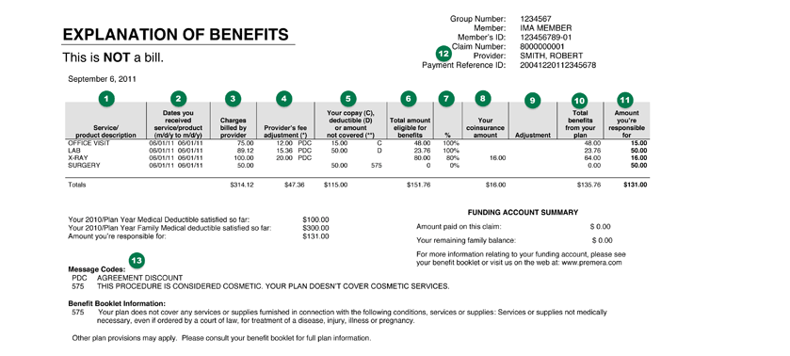
Notes:
http://www.patientadvocate.org/index.php?p=441

