Slide 1
Balance Sheet

Slide 2
PARTS OF BALANCE SHEET
Snapshot @ a given point
Statement of financial position
Assets – liabilities – equity
Compare previous and current and look for big changes and think about what that means

Slide 3
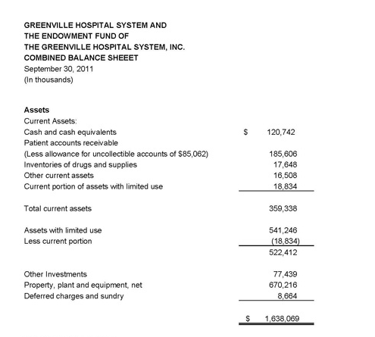
ASSETS

Slide 4
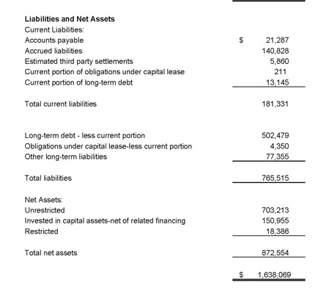
LIABILITIES

