Slide 1
Module 8
Hospitals
Student lecture

Slide 2
Be able to define hospitals
Old hospitals
Quarantine the sick
_________________________________________
New hospitals
Institutions to care for the sick
___________________________________________
Biggest user of health care funds
_____________________________________________

Slide 3
Understand modes of care offered by hospitals
See PP

Slide 4
Understand the findings from F. Nightingale’s Notes on Hospitals
See PP

Slide 5
Understand classification of hospitals

Slide 6
Levels of care
Preventative
________________________________________________________
Primary
_________________________________________________________
Secondary
__________________________________________________________
Tertiary
_______________________________________________________
Quaternary
___________________________________________________________

Slide 7
Types of hospitals/hc facility
Private v. Public
NFP V. FP

Slide 8
Understand the historical development of the modern hospital
Multiple factors transformed hospitals
Flexner Report
_________________________________________________________
Germ theory = Louis Pasteur
___________________________________________________________
Advancements in medical technology
____________________________________________________________
Increased urbanization
____________________________________________________________
_____________________________________________________________

Slide 9
History of hospitals in the US
See PP

Slide 10
Understand hospital accreditation
Used to be called JCAHO
Joint Commission: An independent, not-for-profit organization, The Joint Commission accredits and certifies nearly 21,000 health care organizations and programs in the United States. Joint Commission accreditation and certification is recognized nationwide as a symbol of quality that reflects an organization’s commitment to meeting certain performance standards.
Accreditation: Joint Commission accreditation can be earned by many types of health care organizations, including hospitals, doctor’s offices, nursing homes, office-based surgery centers, behavioral health treatment facilities, and providers of home care services.
Certification: Certification is earned by programs or services that may be based within or associated with a health care organization. For example, a Joint Commission accredited medical center can have Joint Commission certified programs or services for diabetes or heart disease care. These programs could be within the medical center or in the community.

Slide 11
Joint Commission continued
Costs: $______________________ for a full hospital survey
In addition, reimbursement for surveyors
Consultation, post-visit
About every _____________ years
_________________________
_________________________________________
_________________________________________________

Slide 12
Understand hospital finances: Sources of revenue
Sources of revenue
Philanthropy = Donations made to the hospital
Grants = Grants are funds that are donated for a specific purpose.
Tax appropriations are a form of grant, with the donor being the government
Global budgets = Discussed previously. Has no incentives to attract more patients or reduce costs
Charges = List prices, a price for whatever it likes but rarely does insurance pay this amount
Per diem = Rate per day
DRGs = Prospective payment system. Payments based on patient’s diagnosis at discharge.
Capitation = Payment per person
Managed care contracts = Payment is usually made on the basis of per diems, discount charges, or a negotiated fee schedule

Slide 13
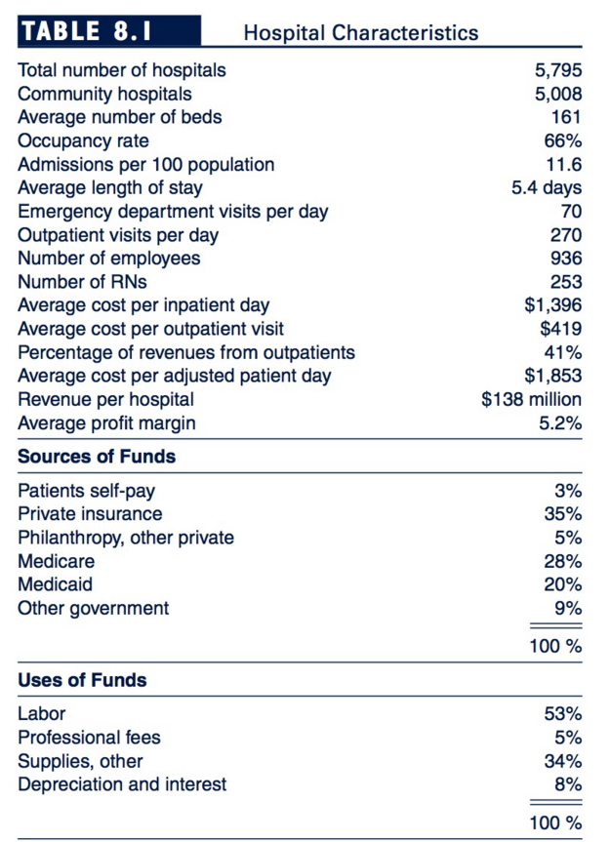
Understand basic characteristics of hospitals

Slide 14
Understand hospital expenses
What do hospitals spend their revenue on?
Labor accounts for the bulk of their costs
Payroll, professional fees, and local services make up about _________% of the budget
Surgery and many other physician services are paid for separately
_______________________________________________________
Hard to cut costs, easier to reduce salaries and benefits

Slide 15
Understand how hospitals compete for
Patients
How do you get patients to comes to your hospital?
Physicians
How do you get providers to come work for you?
Insurance contracts
How do you get Insurance companies to contract with you?

Slide 16
Patients
Biggest things hospitals do is differentiate
________________
________________
________________
________________
________________
________________
________________
________________
________________
________________
Why: People don’t understand; Disconnect between what is measures and what people think is most important
Most important patient satisfaction

Slide 17
Providers
Guarantee income
Relocation
Referrals to start-business
Sign-on bonus
Cover overhead
Hospital’s reputation
Unique technology

Slide 18
Insurance contracts
Being flexible
Avoid competition
How?
Buy up competition
Keep competition away

Slide 19
Understand different types of budgets
Managers control costs, primary through the use of a budget = a plan stated in dollars
Fixed budget = a budget that does not change with volume (aka standard)
Flexible budget = a budget that changes with volume
Operating budget = projects all anticipated expenses for the year
Strategic (aka long-run capital budget) focuses on trends in the number of patients and capital renovations and expansions

Slide 20
Understand economies of scales and diseconomies of scale
Economies of scale = Hospitals exists to allow a large number of doctors to share expensive capital equipment and cooperate in their care. This allow EOS where the average cost per patient-day falls as more patients are treated
Diseconomies of arise = difficulty in coordinating and managing larger institutions.
______________________________________________________________________________________________________________________________

Slide 21
Understand methods to control hospital costs through regulations
CON = legislation requiring that a planning body conduct a study and approve any capital project that would increase the number of beds in the region.
______________ administered price controls in 1971. Rate setting through budgetary review
1984 = Prospective payment setting = change hospital reimbursement to DRGs
BBA of 1997 = reduced Medicare payments to physicians, etc.

Slide 22
Understand how to calculate DRG
Payment = Base rate x Wage Index x MS-DRG weight

