Slide 1
Module 1
Health care economics
Introduction to health care economics
Student’s Notes

Slide 2
Understand core concepts of economics
Economics provides a toolkit that allows us to anticipate or predict how a change in one factor will influence something else
Economist are social scientists who study specific kinds of relationships
Econometrics is the use of mathematical and statistical techniques to test theories; evaluate the appropriate of specific assumptions, etc.

Slide 3
Understand how health care is related to the most important problems facing the US

Slide 4
Understand basic economic terminology
Opportunity cost = the loss of potential gain from other alternatives when one alternative is chosen
Fundamental theorem of exchange = Voluntary exchange benefits everyone even though one party may be better off than another
Trade = buying and selling goods and services
Market (simple vs. complex) = place to buy and sell goods and services
Resources = are the goods or services available to individuals and businesses used to produce valuable consumer products
Choices = Making a decision when you have more than one option. In economics, you would base the decision on which will give you the most benefit without going over your cost (maximization)

Slide 5
Understand basic economic terminology
GDP = measures the value of all final goods and services produced in an economy in a given period of time, usually a quarter or a year.
Scarcity = having seemingly unlimited human wants in a world of limited resources. Because of scarcity, decisions need to be made how to allocate sources
Invisible hand = The unobservable market force that helps the demand and supply of goods in a free market to reach equilibrium automatically

Slide 6
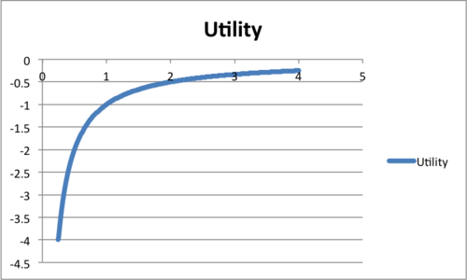
Economic term cont.
Economics suppose that you can compare all possible things that you may experience with common measure of happiness or satisfaction called utility
Margin = decisions are made at the margin (unit of consumptions)
Marginal utility = is defined as that extra utility achieved by consuming on one more unit of a good.
Diminishing marginal utility = each additional unit that is consumed brings less utility than the previous unit so that the extra utility brought by each successive unit diminishes as you consume more and more units

Slide 7
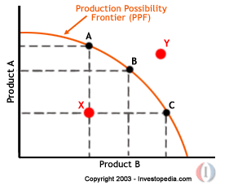
Economics terms continued
Production possibilities frontier = shows how limited resources limit your ability to produce a product
3 areas

Slide 8
Understand core principles of macroeconomics and its relationship to health care
The class is focused on microeconomics
What is macroeconomics
Means large
Deals with large-scale properties and institutions that characterize the system as a whole

Slide 9
Macroeconomics and health care
Consumption function = Relationship between income and spending (consumption) is known as the consumption function.

Slide 10
Macroeconomics and health care
Permanent income hypothesis = The amount consumed is determined by expected average earnings over the long-term rather than current earnings today.

Slide 11
Macroeconomics and health care
Shared income = The average income of a group of people who share determines their consumption, rather than the earnings of each person individually

Slide 12
Macroeconomics and health care
Relative income hypothesis proposes than an individual’s purchasing and savings are determined by income relative to the income of others in the community.

Slide 13
Macroeconomics and health care
Relative position (or rank) hypothesis maintains that, in addition to individual income, a person’s position within the community also determines his health status

Slide 14
Understand basic concepts of health care economics

Slide 15
What is health?
WHO defines health as a state of complete physical, mental, and social well-being and not merely the absence of disease and infirmity.
In the US, the concepts of health and health care have largely been governed by the medical model which presupposes the existence of illness or disease.

Slide 16
What is economics?
Economics is the science that analyzes how people and societies make decisions that allow them to get the most out of their limited resources.
Microeconomics: focuses on individual people and individual businesses.
Macroeconomics: looks at the economy as an organic whole, concentrating on factors such as interest rates, inflation, and unemployment

Slide 17
HEALTH VS. HEALTH CARE ECONOMICS
Health economics is the study of how resources are allocated to and within the health economy

Slide 18
Understand why health/health care economics has its own economic field of study
Health care is valued
Normal free markets don’t lead to better care
Problem with health care and why we specifically study it is because it doesn’t always follow the norms of the market
Many entities involved
Size of the health care sector to overall economy
National policy
Many health issues have substantial economic elements

Slide 19
Understand the factors that influence health status
Factors that influence individual and population health status
Individual behavior (most influential)
Genetic makeup
Medical practice
Environment
Income
Education
Housing
Government programs

Slide 20
Understand the social determinants of health
Social determinants of health are conditions in the environments in which people are born, live, learn, work, play, worship, and age that affect a wide range of health, functioning, and quality-of-life outcomes and risks

Slide 21
Describe key aspects of health care spending in the US
3 pillars of any health care system
3 trillion dollar business
$10,000/person/year
Costs grow faster than inflation
High tech/high touch industry

Slide 22
Inflation
Inflation is an increase in the price of a basket of goods and services that is representative of the economy as a whole
http://data.bls.gov/cgi-bin/cpicalc.pl

Slide 23
Sources of payers and sources of coverage
Sources of payers
Government = 50%
ESHI = 31%
Self-paid = 11%
Charity = 7%
Sources of coverage
ESHI = 48%
Government = 30%
Uninsured = 17%
Individual private health insurance = 5%

Slide 24
Users of health care funds
Who uses funds? Top 5
Hospitals
Physicians
Drugs
Administration and insurance
Nursing home

Slide 25
What is driving health care costs

Slide 26
Describe the important/unique aspects of health care economics
Unpredictability of need and costs
Patients have to rely on others for recommendations
Due to insurance, tax codes, and taxes we don’t see the full cost
Extent of government involvement
Uncertainty

Slide 27
Important/unique continued
Asymmetric knowledge
Externalities
Illness is contingent, urgent, and uncertain
Health is priceless
Health affects values of other goods

Slide 28
Important/unique continued
Prominence of insurance
Problems of information
Large role of NFP
Restrictions on competition
Role of equity and need
Health care is a high-tech/high-touch industry.

Slide 29
Health disparities
Health disparities refer to differences in the health status of different groups of people. Some groups of people have higher rates of certain diseases, and more deaths and suffering from them, compared to others.
Common types
Race
Ethnicity
Immigrant status
Disability
Sex or gender
Sexual orientation
Geography
Income

Slide 30
Understand Rational choice theory
Rational choice theory = People make choices that make themselves better off. Doesn’t mean they make the best choices, but they choose things that make themselves better off than worse

